Slide 1
Thyroid Cancer Recurrence

Slide 2
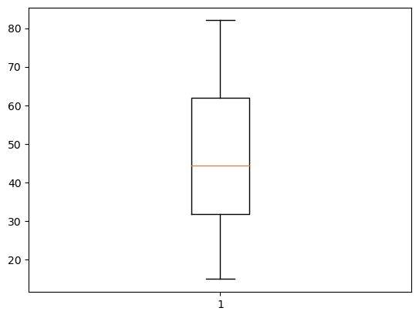
Ages of Patients vs Recurrence
The box plot shows that the ages of patients with recurrence range from 15 to 82.
The interquartile range shows that most of the people who had a recurrence of thyroid cancer are of between the ages 32 and 62.
The data is positively skewed.

Slide 3
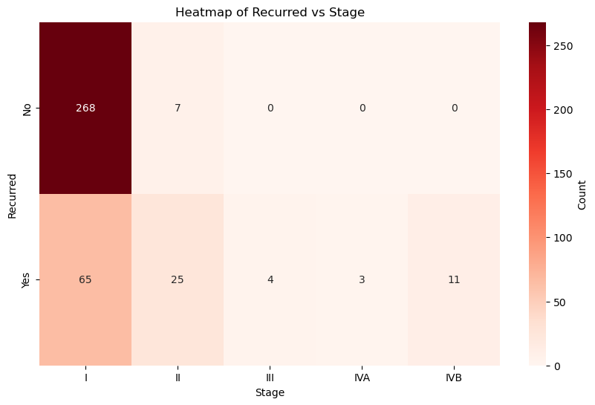
Recurrences vs stage
We can see that the chances of recurrences increase with the stage of the cancer.

Slide 4
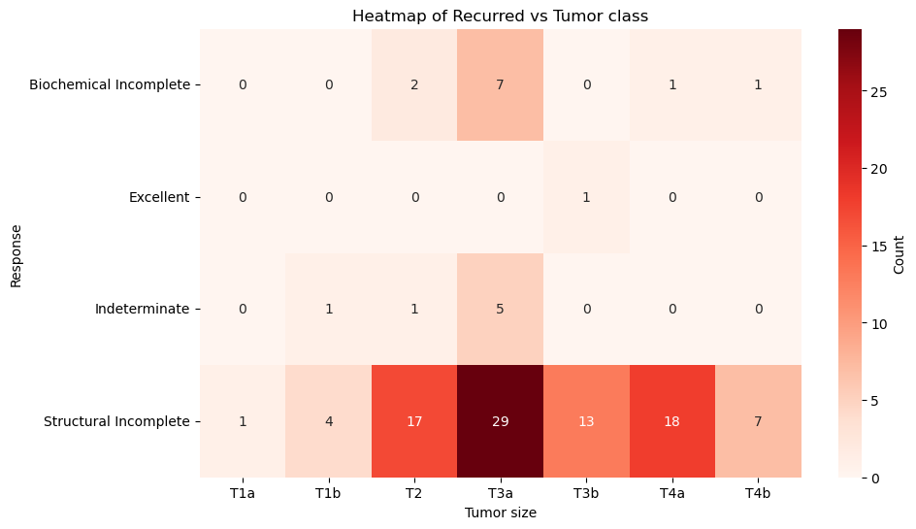
Recurrences vs Tumor Class
From this heatmap we can see that the chances of recurrences are highest with the T3a tumor class.

Slide 5
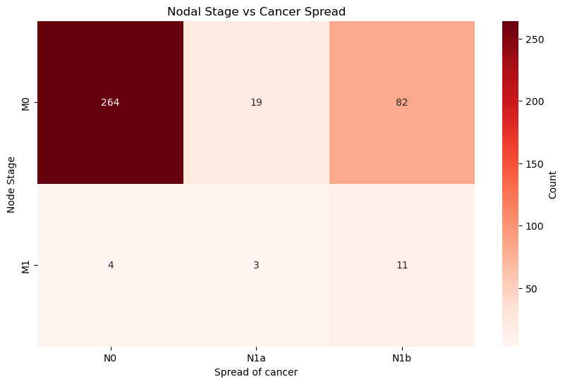
Nodal Stage vs Metastasis
We observe an unexpected relationship between metastasis (spread of cancer) and chances of recurrence.
If the patient has a documented history of distant metastasis, their chances of recurrence is far lesser than otherwise.

Slide 6
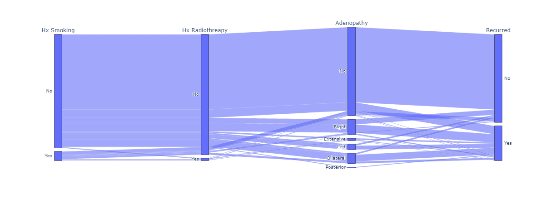
Impact of Smoking and/or Radiotherapy
This plot shows us that a history of smoking or radiotherapy indicates a higher chance of recurrence.
Having swollen lymph nodes puts the patient at risk for a recurrence as well.

Slide 7
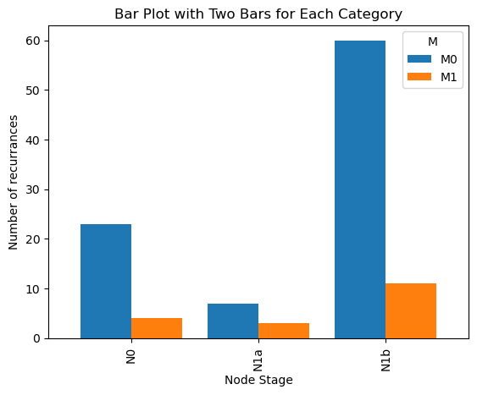
Recurrence vs Pathology
From this plot we observe that there is a much higher chance of recurrence in patients with the Papillary cancer type.

Slide 8
Conclusion
The insights gained from this analysis serve as valuable contributions to the ongoing efforts to combat this formidable malignancy as cancer has been a serious concern for people. As we reflect on this report, it becomes clear that this project has not only deepened our comprehension of thyroid cancer but also provides actionable recommendations for clinicians and researchers to enhance healthcare options for thyroid cancer patients and improve their outcomes.

